Slide 1
Rate my Tweet: comparative Judgement in the wild
Andy Gray
445348

Slide 2




Stakeholders & Academic Team
Alma Rahat (Lead)
Tom Crick
Stephen Lindsay
CDSM (Stakeholder)

Slide 3
Overview
Motivation
Background
Methodology
Demonstration
Results
Conclusion

Slide 4
Overview
Motivation
Background
Methodology
Demonstration
Results
Conclusion

Slide 5

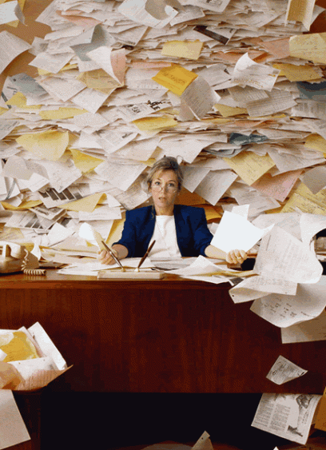
Motivation
For the prior eight years, I have had involvement in some form of an educational environment.
Seven of these years involve being a teacher within secondary and sixth form schools.
While the focus of teaching is perceived to create lessons for students to learn and grow, we found more and more as the years went on that this wasn't the case.
The focus was on providing reports about the students, which required data from formal assessments.
While having assessments to gauge the level that a student is at is an essential part of education.
Creating, marking, analysing and providing feedback for 30 students or more per class is a time-consuming task.
Therefore, this assessment practice takes away the educators' time to do what is essential, creating meaningful lessons tailored for the students.

Slide 6

Motivation
Is to create a tool for educators that will empower them.
Allowing the technology to do what it is good at and allowing the teachers to focus on what they are good at.
creating and delivering lessons, to shape future generations.

Slide 7
Overview
Motivation
Background
Methodology
Demonstration
Results
Conclusion

Slide 8

Background
Within our project there was 3 main focus areas:
The role of Marking and Feedback within Teaching and Learning
Comparative Judgement
Other Types of Ranking Systems

Slide 9

Background – Marking and Feedback
Educators conducting marking and feedback provides multiple benefits:
A means to assess students attainment levels
Diagnostic
Formative – Assessment for Learning (AfL)
Summative – Assessment of Learning (AoL)
The ability to rank students
To provide feedback
To empower the students
With information on what they done well
With what they can improve on

Slide 10

Background - Marking and Feedback
The feedback is only helpful if the students get a chance to act on it
The task creates a huge cognitive load on the teacher
It is hard for the teacher to remain unbiased
It requires a lot of time to conduct

Slide 11
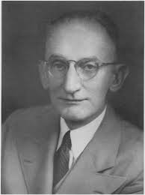
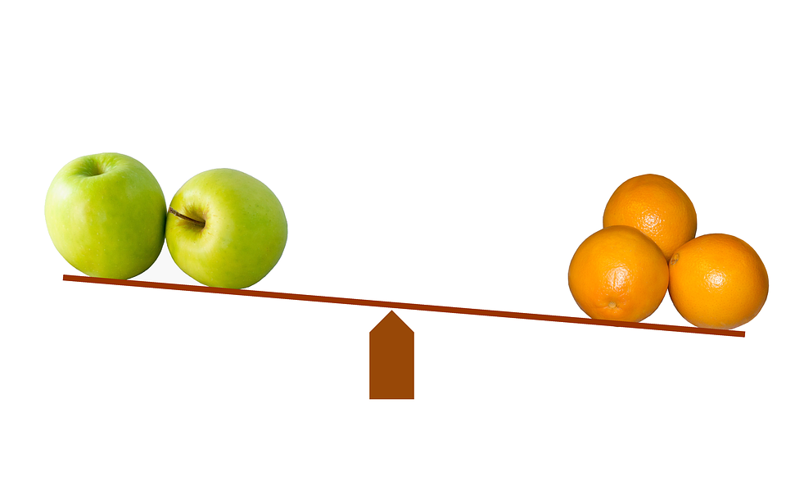
Background – Comparative Judgement
Explain CJ
Introduced by in 1927
By Louis Leon Thurstone – A Psychologist
Referred to as ‘the law of Comparative Judgement’
Humans are good a comparing two items side by side
Requires a pairwise comparison of all unique combinations
Rank orders the outcome

Slide 12

Background – Comparative Judgement
In the educational space Adaptive Comparative Judgement (ACJ) has been adopted
How it Works:
Provides pairwise comparisons
Requires markers (judges)
Requires rounds
Adaptive by making pieces of work similarly scored appear more often
Very high accuracy rates

Slide 13

Background – Comparative Judgement
Although ACJ provided some benefits, it does have multiple flaws:
It increased the actual work load for teachers
Through it having multiple judging rounds
ACJ would take longer than marking using a regular method - Using a rubric
Additionally ACJ does not provide any personalised feedback for the teachers or students
Its adaptive nature causes bias in the results
Accuracy is not much difference if the samples were just produced randomly

Slide 14

Background – Other Ranking Systems
Elo
Created by Arpad Elo in the 1960s
Introduced in the USCF is its method of ranking in the 1980s
Used in multiple scenarios from esports to traditional sports like football, American football and basketball
It does have some flaws:
protecting one’s rating,
selective pairing
ratings inflation and deflation.
Glicko
Created by Mark Glickman
It worked similar to the Elo system but addressed many of Elo’s flaws
This was through using a RD measure, which increases over time with inactivity

Slide 15
Overview
Motivation
Background
Methodology
Demonstration
Results
Conclusion

Slide 16


Methodology – Overall Aim
Cognitive Load
Work Load

Slide 17








Methodology – Overall Aim

Slide 18

Methodology – Tweets
An Englishman, a Scotsman and an Irishman walk into a bar. The Englishman wanted to go so they all had to leave. #Brexitjokes"
Why do we need any colour passport? We should just be able to shout, “British! Less of your nonsense!” and stroll straight through.
Q: With Britain leaving the EU how much space was created? A: Exactly 1GB"
VOTERS: we want to give a boat a ridiculous name UK: no VOTERS: we want to break up the EU and trash the world economy UK: fine"
#BrexitJokes How did the Brexit chicken cross the road? "I never said there was a road. Or a chicken".
After #brexit, when rapper 50 cent performs in GBR he'll appear as 10.00 pounds. #brexitjokes
I long for the simpler days when #Brexit was just a term for leaving brunch early.
Say goodbye to croissants, people. Delicious croissants. We're stuck with crumpets FOREVER.
Hello, I am from Britain, you know, the one that got tricked by a bus"
How many Brexiteers does it take to change a light bulb? None, they are all walked out because they didn’t like the way the electrician did it.

Slide 19
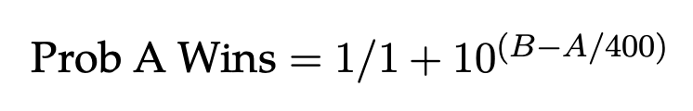
Methodology – Elo Ranking
The first step looks into the probability that A win (This is the expected score)
This generates the new Elo ranking score.
Rating = the players current Elo score
If a player wins the score = 1
If a player loses the score = 0

Slide 20
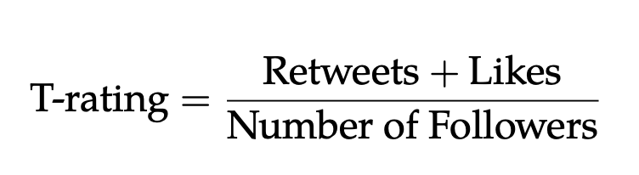
Methodology – T-rating
Notes:
Talk about it being a weighted sum method.
And that we know that it is a bit more complex than this to how interconnected Twitter is (as a retweeted could have had a higher number of followers which gives it more traction)
And that studies around this has been done for creating tweet rankings by using a number of methods and sentiment score.
However, we decided that due to certain time limitation this approach would be suffercent to see if there is a pattern emerging.

Slide 21

Methodology – NLP Techniques
Information Extraction
Part of Speech (POS) Tagging
Named Entity Recognition (NER)
Feature Extraction
Sentiment Analysis
Text Similarity
Utterance Pattern Matching
Finding Word Sequence Patterns
Key Phrases

Slide 22
Overview
Motivation
Background
Methodology
Demonstration
Results
Conclusion

Slide 23
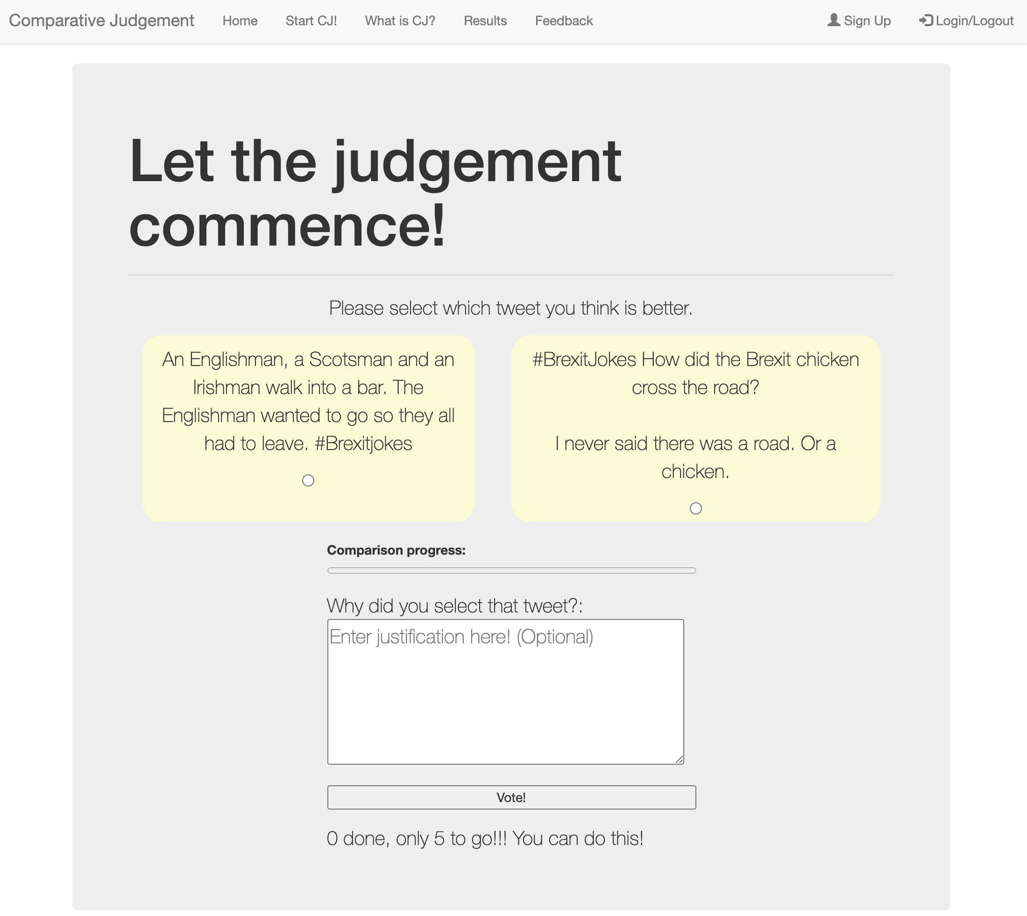

Demonstration
https://comparative-judgement-web-app.herokuapp.com/

Slide 24
Overview
Motivation
Background
Methodology
Demonstration
Results
Conclusion

Slide 25
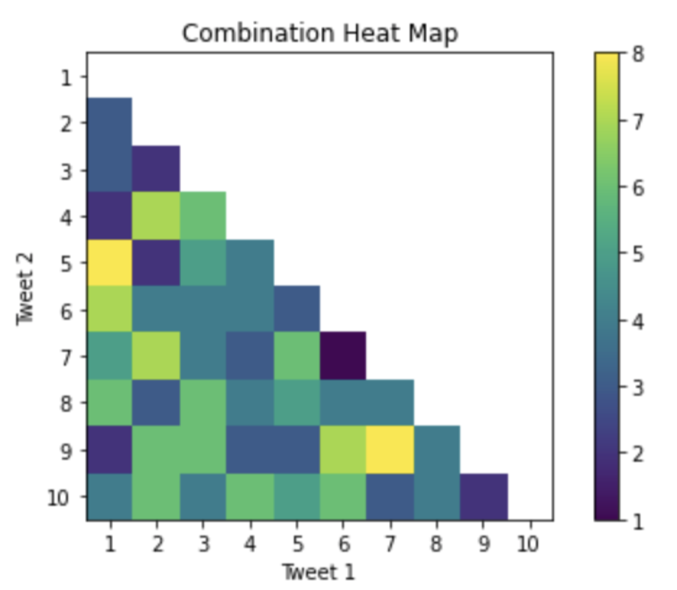
Results
40 users took part
All the tweets were used
Tweet 1 vs Tweet 5 and Tweet 7 and 9 were the highest occurring tweet combinations
Tweet combination 6 & 7 appeared the least

Slide 26
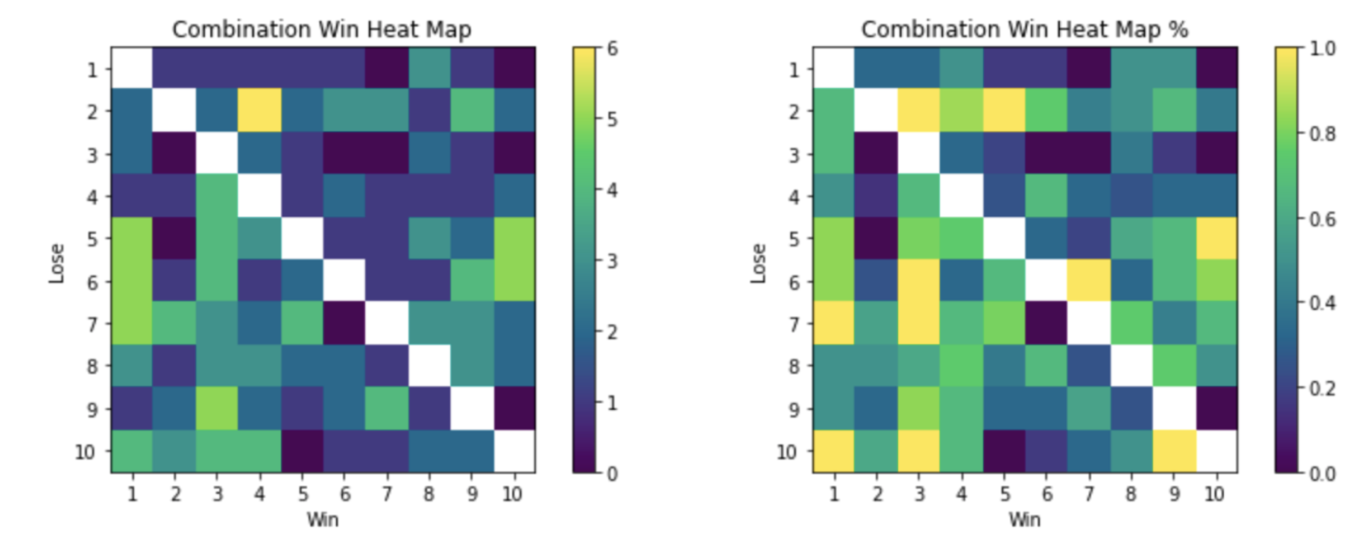
Results
10 tweet comparisons resulted in the same tweet winning 100%
Tweet 4 beat Tweet 2 the most (6-1)
Tweets 2, 5, 6, 7 & 10 had moments where they didn’t win a certain tweet
Tweets 2, 5, 6, 7 & 10 didn’t win against two tweets

Slide 27
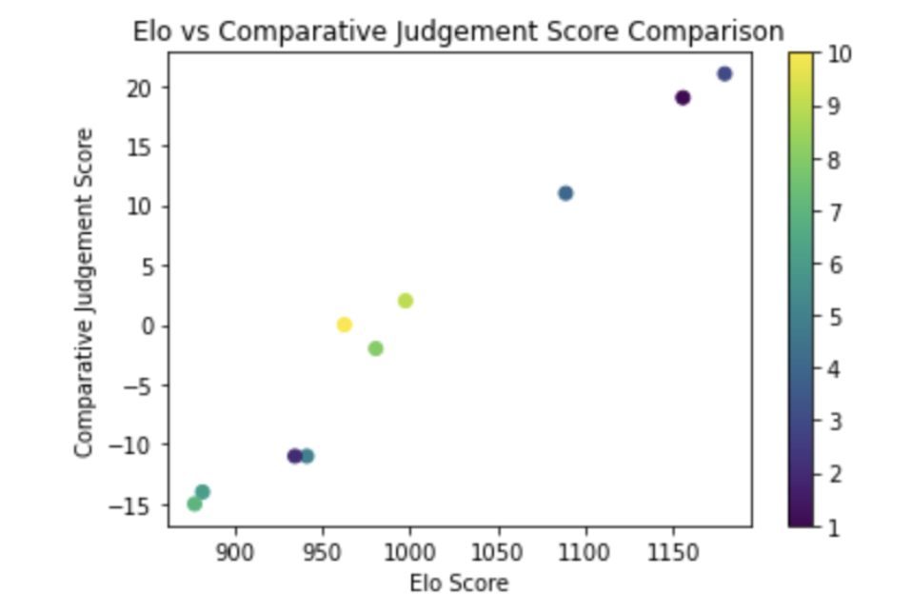
Results
Positively correlated
Pearson's Score: 0.98391595

Slide 28
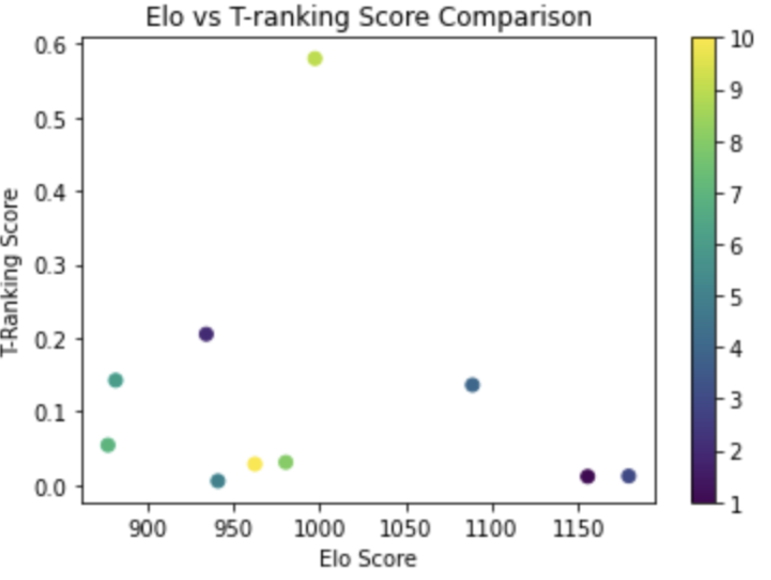
Results
Elo: -0.14360792
CJ: -0.09776676

Slide 29
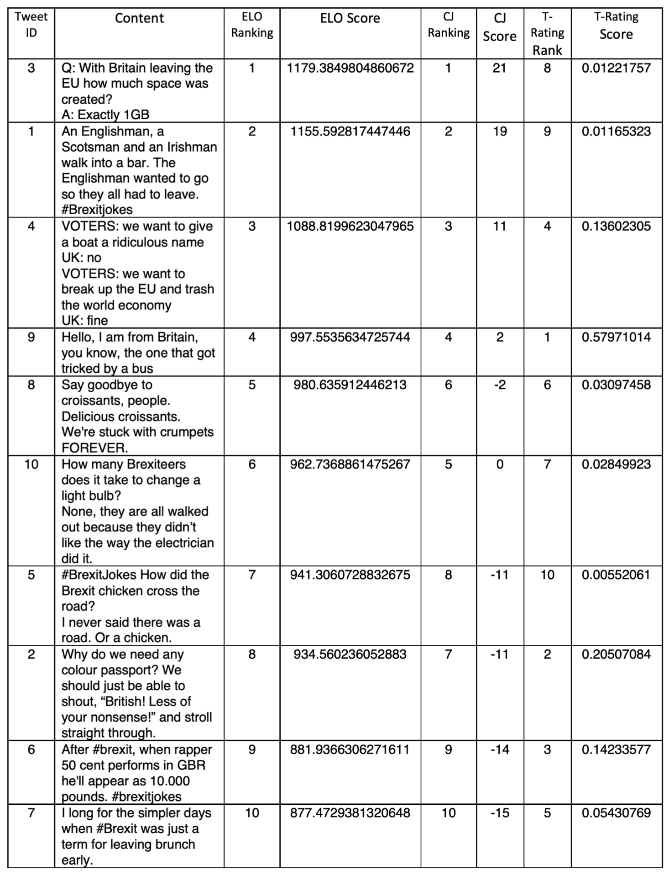
Results
Elo and CJ ranking generated very similar results.
Tweets coming in 6th, 7th, and 8th slightly vary in the results
Elo against T-rating are very different:
The tweet that came 1st in the T-rating came 4th in the Elo ranking
1st in the Elo ranking came 8th in the T-rating
4 of the top 5 tweets in the T-rating were actually in the bottom five of the Elo ranking
Elo was able to handle the element of random pairing well

Slide 30
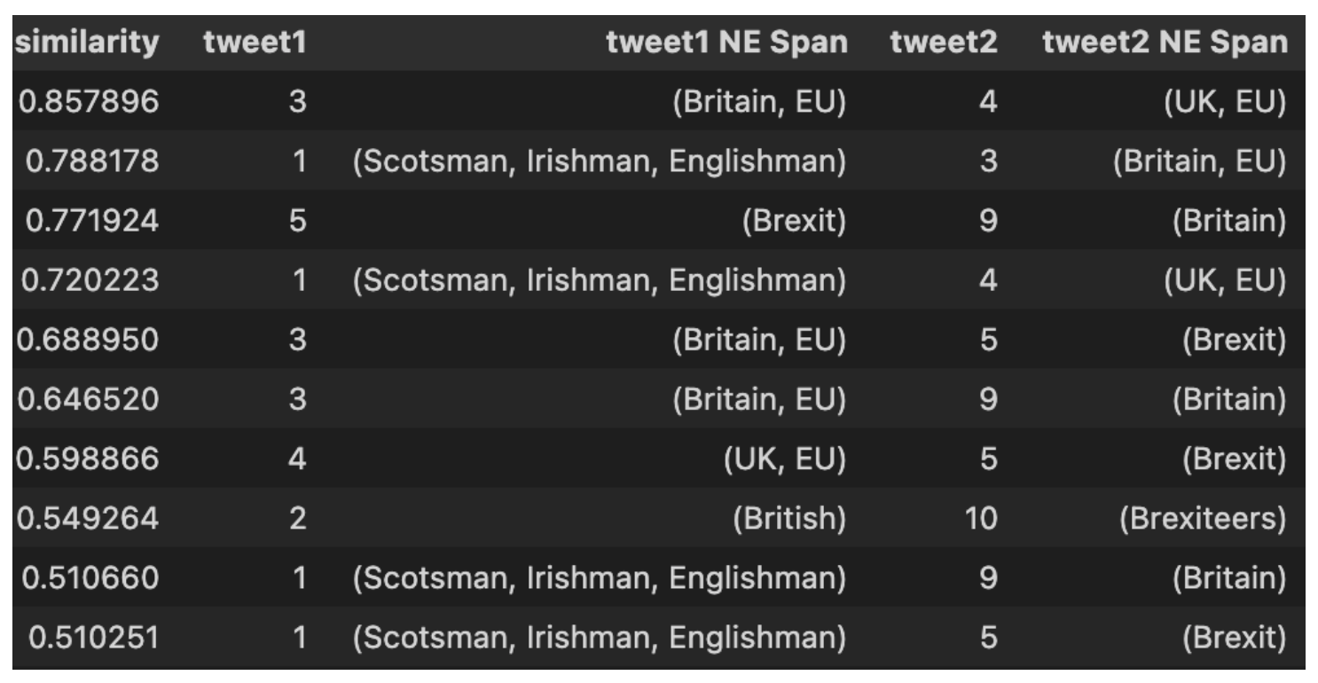
Results
Q: With Britain leaving the EU how much space was created? A: Exactly 1GB”
VOTERS: we want to give a boat a ridiculous name UK: no VOTERS: we want to break up the EU and trash the world economy UK: fine"

Slide 31
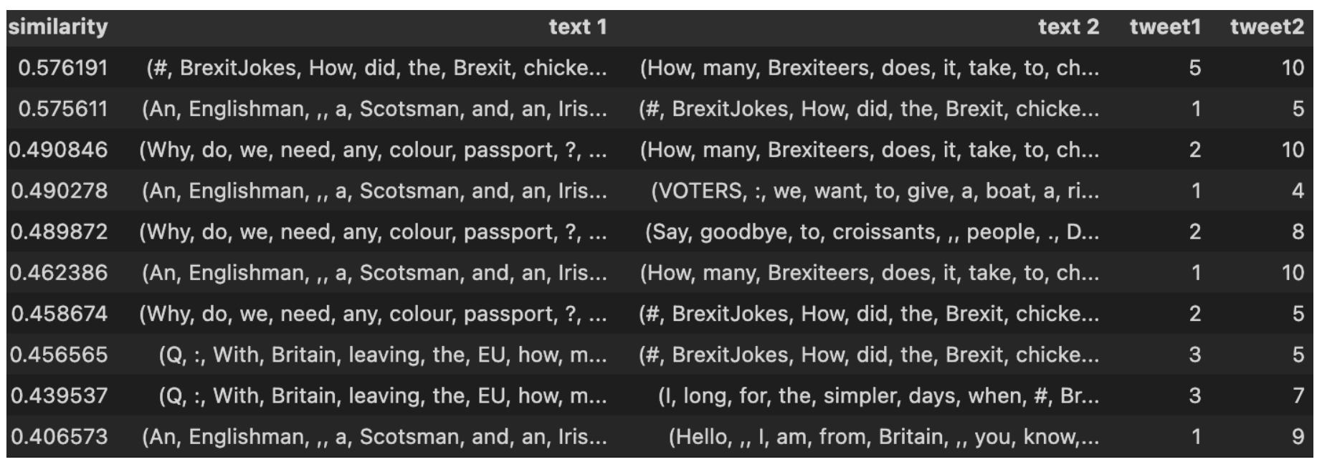
Results
#BrexitJokes How did the Brexit chicken cross the road? "I never said there was a road. Or a chicken".
How many Brexiteers does it take to change a light bulb? None, they are all walked out because they didn’t like the way the electrician did it.

Slide 32
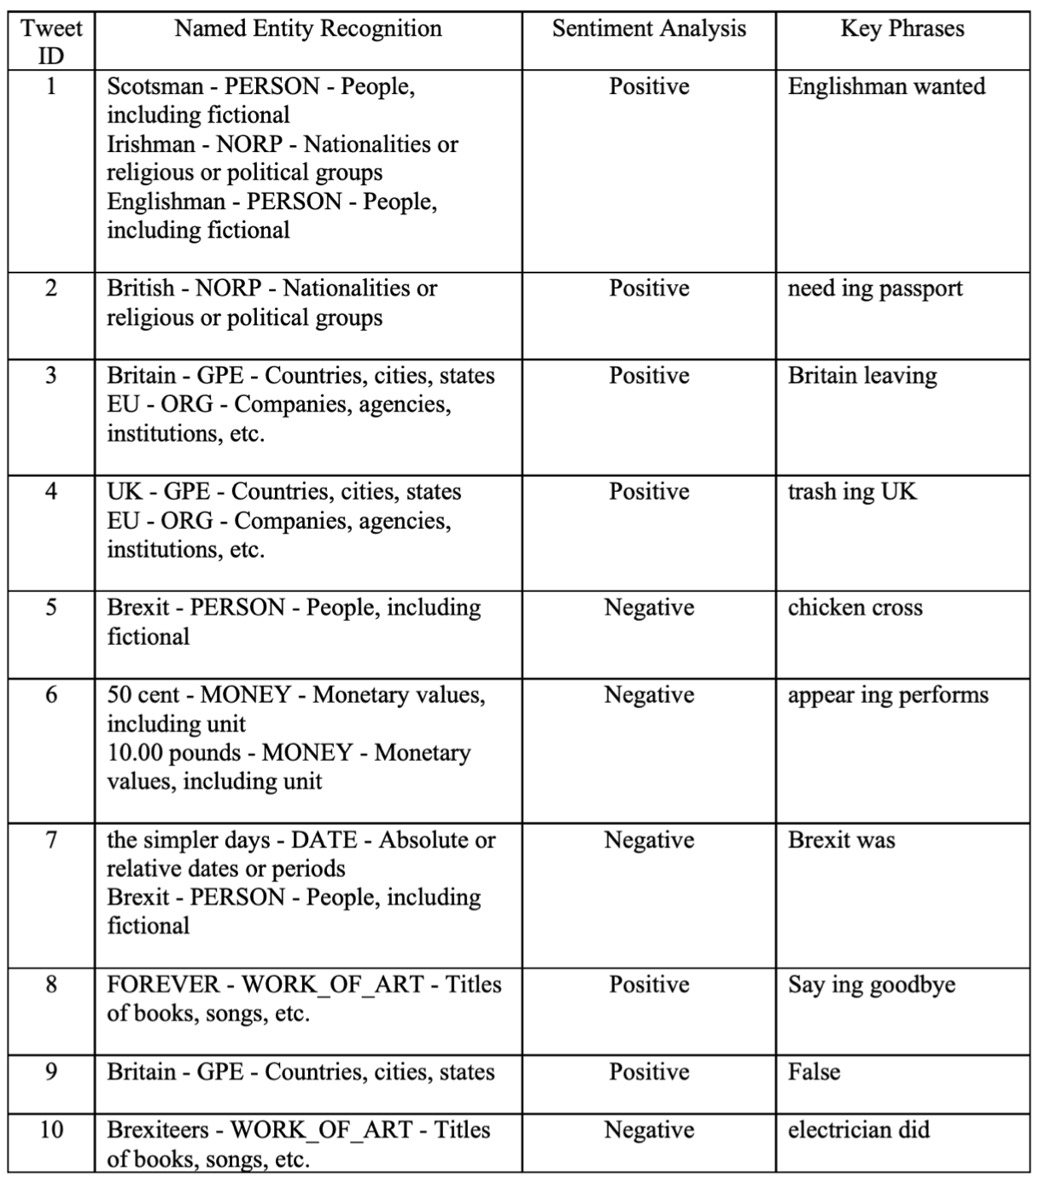
Results
Six of the tweet’s sentiments scoring got classified as positive
Five were in the top 5 results
The key phrases provided some good insights
Apart from Tweet 7
The POS and NER provided some good insights but not enough to do anything meaningful with them currently

Slide 33
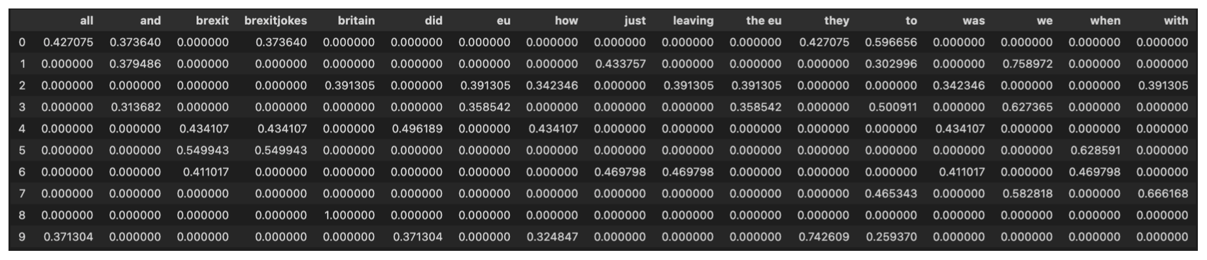
Results
TF-IDF process provided the key tokens for feature extraction
Not much insight was gained
For this to be meaning full it needs to be part of a pipeline for something else

Slide 34
Overview
Motivation
Background
Methodology
Demonstration
Results
Conclusion

Slide 35

Conclusion
Overall, Elo seems like a good alternative to CJ
Elo was able to handle the element of random pairing well
Both the Elo and CJ score were positively correlated
The Elo system was able to remove the need for multiple judging rounds
T-ranking was negatively correlated to both Elo and CJ score
NLP created some good building blocks but no meaningful feedback at present

Slide 36

Future Work
A bigger sample pool to conduct the study on to see Elo’s effect
Tracking the time it took for marking to be done using the Elo system
Converting the Elo score results to grade marks - i.e: GCSE grades
Exploring the NLP capabilities more in providing personalised feedback

Slide 37

Questions & Answers

